Slide 1














GenAI
PPT with GPT
Naan Mudhalvan Project
<>
Maniish Raja V K - 2021506046

Slide 2
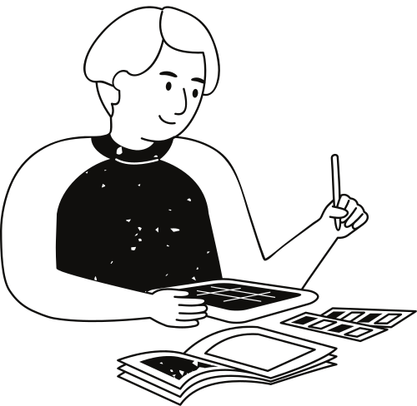
Origin of the creative idea
Our creative journey began with a spark of inspiration drawn from the intersection of neuroscience and technology.
Fascinated by the brain's complexity and its potential applications in artificial intelligence, we embarked on a quest to explore the neural mechanisms underlying creativity.
This led us to delve into the realm of Generative AI, where we sought to harness the power of machine learning to unlock new frontiers of creativity.

Slide 3
Vision Statement: Our vision is to create a future where the boundaries between human creativity and artificial intelligence blur, fostering a symbiotic relationship that empowers individuals and organizations to achieve their fullest potential.
01.
Project vision and mission
Empowerment through Technology: We are dedicated to developing cutting-edge technologies that democratize creativity, providing accessible tools and resources to inspire and enable people from all walks of life.
02.
Our project's vision and mission encapsulate our aspirations and guiding principles, driving us towards our ultimate goals with clarity and purpose. With a clear vision of the future we envision and a mission that defines our path, we are committed to making a meaningful impact through innovation and collaboration.
Impact Goals & Foster Creativity: Our project aims to ignite and nurture creativity in individuals and communities worldwide, empowering them to explore, experiment, and express themselves freely.
03.

Slide 4
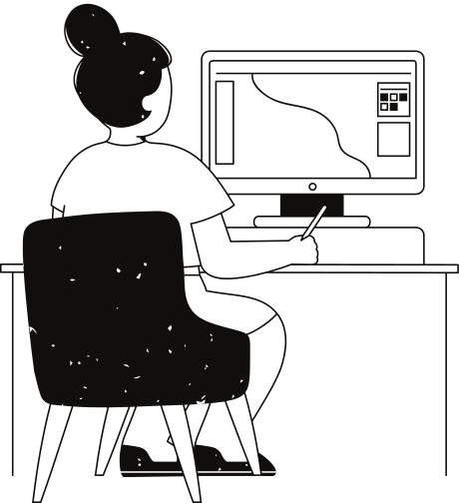
Inspiration and creativity
Inspiration and creativity are the lifeblood of our project, driving us to explore new horizons, push boundaries, and envision possibilities beyond the conventional. Rooted in a deep appreciation for the human spirit and the power of imagination, our journey is fueled by moments of inspiration and the transformative force of creative expression.

Slide 5
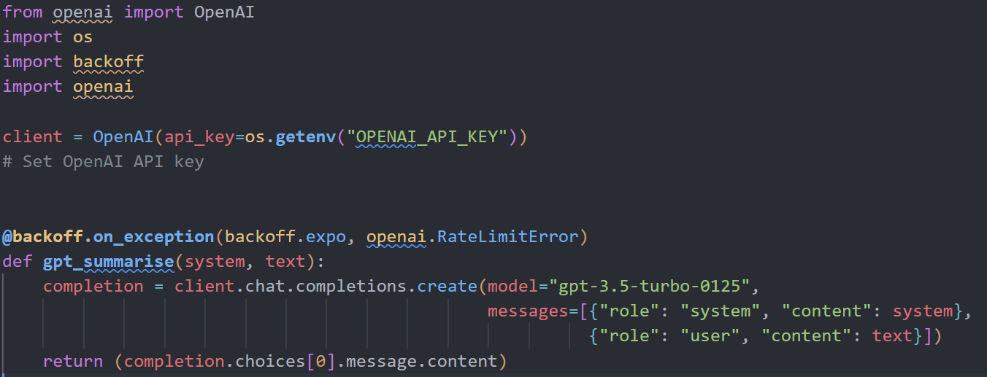
GPT CODE

Slide 6
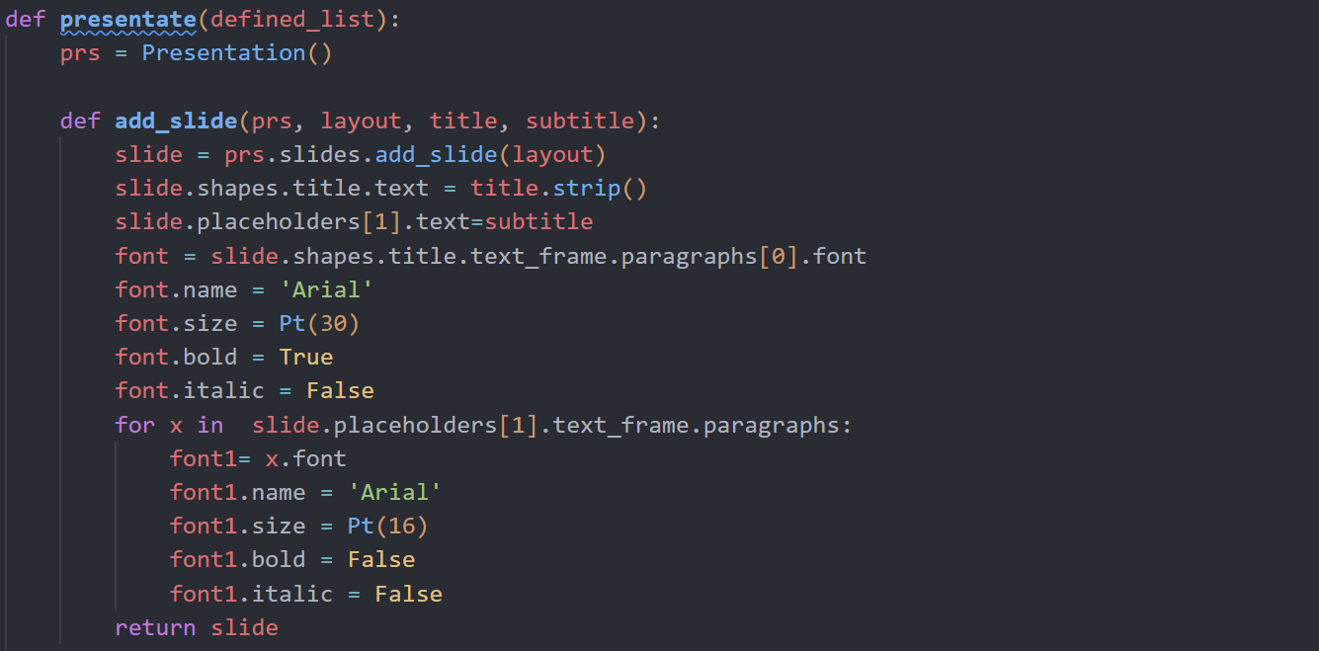
PPT Generation Code

Slide 7
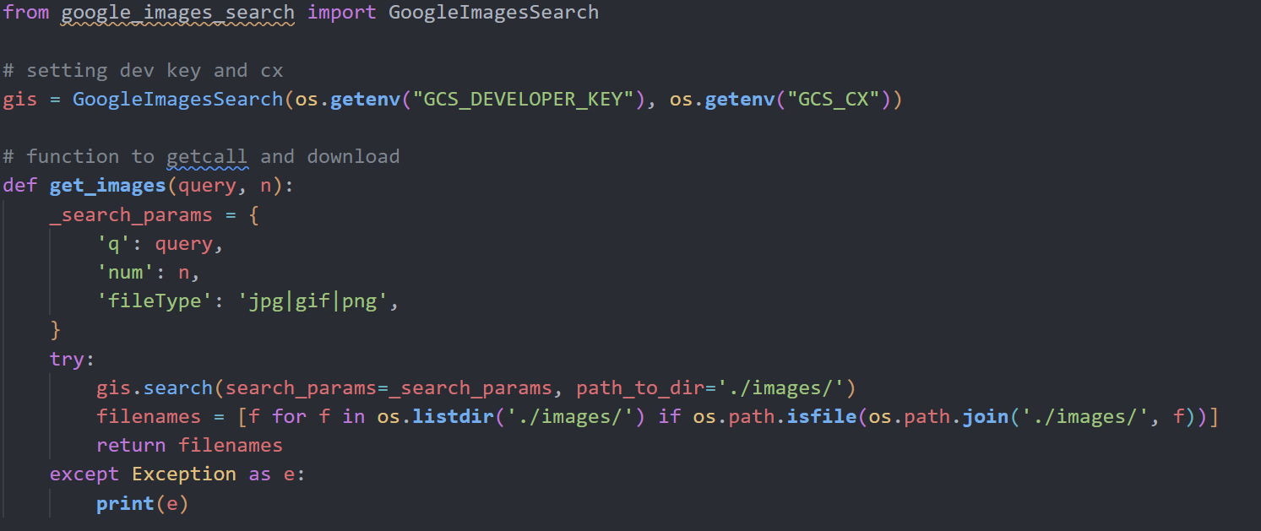
GoogleImageSearch API

Slide 8
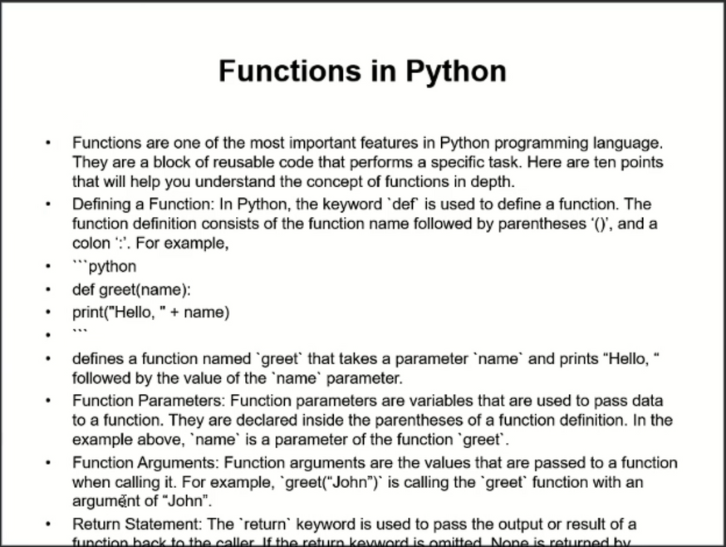
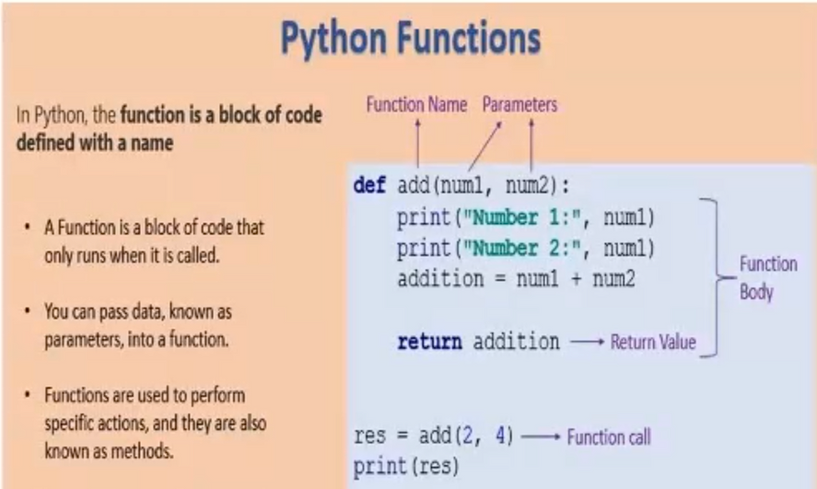
OUTPUT
Page - 1
Page - 2

Slide 9
Thank you very much!
Maniish Raja V K - 2021506046

